Slide 1
Testing Functional Code
Exercise:
- Retrospective

Slide 2
The purpose of this lesson is to show it is possible to have code that is simple to test…
Because many people have never experienced that.
Notes:
When you come across code that isn’t easy to test, we want you to be able to compare that with this, and say “what’s different?”
And to change it, so it feels like this
Great thing about being a programmer: We are not trapped in the current code… But you can be trapped if you are not aware that another option exists.
We want to show you that code can be easy to test –
and when it’s not, we want you to not accept it, and to start asking why is it not?
later on, we’ll show you tactics to make it easy to test – but for now, this is about awareness
golden balls. the weirdest split or steal ever!
https://www.youtube.com/watch?v=S0qjK3TWZE8
Where someone changes the rules to add a third option.

Slide 3
Awareness (show) Proficiency (do) Fluency (repeat)
Notes:
We had a lot of repetition today – over and over again
We want you to feel really comfortable in this good place – this is code that is easy to test
If you don’t feel comfortable, we want you to come back to this place
That’s why we did so much repetition today

Slide 4
0 -> 1
Notes:
Adding that first test took longer
The first cycle with the MobTimer look longer
By the end, you were moving really very quickly

Slide 5
Steps 1. Test (fail, get information) 2. Test (pass, locking results) 3. Check coverage (guidance)
Notes:
Here’s what we did:
Wrote tests that we knew would fail
Captured that information in the test code itself
Running tests in future will detect any change in behaviour
This is the normal behaviour when adding tests to legacy code (put aside your preconceived ideas about Sin and Cos)
Then use code overage for guidance

Slide 6

HOW HARD WAS THIS?
Very
Not at all
Notes:
Reflect on what happened today
For you, how did you find this
No judgement on the answers!

Slide 7
HOW DID THIS FEEL?
💬

Slide 8
RESEMBLE YOUR WORK?
Completely
Not at all
Notes:
The we tested, how similar is that to the code you test in your work – is your code nice and easy to test
Are you used to testing simple code - little methods that take numbers and return numbers

Slide 9
EASIER TO TEST… WHY?
💬
Notes:
Probably share the mindmap, for people to type independently – paste link in to Google Doc

Slide 10
Small methods?
#2
double TrigMath::cot(double angle) { auto idx = floor(angle * SIN_CONVERSION_FACTOR); idx += 1; idx = 3.1 * idx; auto dx = 2.1; for ( int i = 0; i <= 10; ++i ) { idx = (idx * dx * 9.7) / 42.0; } idx = integrate(idx, 2, 13); idx += pow(idx, 2); idx = tan(idx); idx = idx * DEG_TO_RAD; idx = integrate(idx, 2, 13); idx += pow(idx, 2); idx = tan(idx); idx = idx * DEG_TO_RAD; idx = integrate(idx, 2, 13); idx += pow(idx, 2); idx = tan(idx); idx = idx * DEG_TO_RAD; return cosRaw(idx) / sinRaw(idx); }
#1
double TrigMath::tan(double angle) { auto idx = floor(angle * SIN_CONVERSION_FACTOR); return sinRaw(idx) / cosRaw(idx); }
#3
double TrigMath::sec(double angle) { return angle / rand(); }
Notes:
Sometimes people think that methods being small is enough to make them easier to test?
Is “small” alone enough to determine if easier to test
No
#2 rand() is in a very small method!
#3 is not small, but flow is simple – only one path through - so easier to test
Small is factor, but it’s not the only factor

Slide 11
Functional Code (Pure Functions)
1. All inputs
2. deterministic
3. All results
Notes:
Today’s focus has been testing what we call “functional code” aka “Pure functions”
The reason that today’s code was easier to test was because they are functional code
you put stuff in
you got stuff out
the results were always the same

Slide 12
Non-Functional Code
(No Inputs)
get inputs from global state;
use random, dates, or other varying data;
write results to global state;
(No Return)
Notes:
If any one of those conditions is not true, the code is not functional by our definition
And then the code is harder to test
Later on in the course, we will give you tactics to use in these situations

Slide 13
All inputs in
public double calculate(double amount)
{
int step1 = (int) (amount * 2);
double step2 = step1 * 1.5;
return step2;
}
Deterministic
All results out
Notes:
Thumbs up for if this is functional/pure?
Yes it’s functional

Slide 14
All inputs in?
public int Advance()
{
return steps++;
}
Notes:
Thumbs up for if this is functional/pure?
Not all inputs passed in – global gets incremented

Slide 15
All inputs in?
public int age(DateTime birthDate)
{
var timeSpan = DateTime.Now - birthDate;
var age = DateTime.MinValue + timeSpan;
return age.Year-1;
}
Deterministic?
Notes:
Thumbs up for if this is functional/pure?
Not deterministic because of DateTime.Now

Slide 16
public void saveFile(Person info, string fileName)
{
File.WriteAllText(fileName, info.ToString());
}
All results out?
Notes:
Thumbs up for if this is functional/pure?
Clue is in the void return type

Slide 17
Why functional is easier for tests
Unit Test
Production Code
Do
Verify
Notes:
Functional code is easier to test
Why? Because good unit tests are also functional
Everything they need comes on
Everything they do comes out – pass/fail
Non-deterministic unit tests are flaky and bad
Functional code composes well with functional code
Functions snap together

Slide 18
Why functional is easier for tests
Unit Test
Functional Harness
Production Code
Do
Verify
Notes:
Functional code does not compose well with non-functional code
Hard to get them to work together
Functional calling to non-functional requires building a functional harness
Weird setup stuff
Weird mocking
Making it deterministic
Functional harness might be:
Before the test runs, go to the file system and delete all logs
At end of test, save the logs
And then read the logs
Another example:
Read a file from disk and then remove all the dates and times, to get stable output
Another example
Mocks

Slide 19
Benefits of Unit Tests
Specification
Feedback
Regression
Granularity
Notes:
Specification is about figuring out what you are trying to build – benefit: future people can know
The moment you start to write tests, you realise what you don’t know, and it drives conversations to fill in the blanks
TicTacToe 4x4 board example
It needs to be quick – how quick?
Feedback is about letting you know, when you are building it, if it is working yet - by executing the code
Regression is “OK I finally got it working today, does it still work tomorrow”
Granularity is “It stopped working, why?”

Slide 20
Benefits of Unit Tests
Specification
Feedback
Regression
Granularity
Notes:
With legacy code, when writing tests after the code was written, you only get the benefit of regression
You don’t get any of the other benefits
You are only recording the current behaviour, to detect future changes in behaviour
The other 3 things, we care about in normal TDD, but not when testing legacy/existing code
Hard to discover intention
Too late for feedback
When things break – it’s temporal, “what did we change recently”

Slide 21
Regression
A
A
If I used to get :
Then I still get :
Notes:
Both

Slide 22
Stages of Approval Testing
REQUIRE (object == "")
Same?
Pass
Fail
Manually inspect the answer
object
Correct, copy to expected
Wrong, fix code
Notes:
This course is about the Approval Tests library – which we haven’t used today
But what we have done today is Approval Testing
That’s the horizontal line on this slide – for legacy code
The first time, it can’t pass – will always fail the first time
It’s never going to be wrong, as we are capturing the current behaviour
Later on, we will show you how to streamline this process, using the Approval Tests library

Slide 23
Locking test
Notes:
Capture the current behaviour

Slide 24

Poke
Notes:
Prod and explore
Explore the current behaviour
Can I even call it all?
We will use this phrase in future sessions

Slide 25
Next Steps
making your code easy to test

Slide 26
Next Steps
making your code easy to test
Notes:
Next week – not doing this, that comes later

Slide 27
Next Steps
better ways of testing functional
making your code easy to test
Notes:
Next week - Better ways of testing code which is functional
How can we make today’s code even easier to test – even nicer place to be
Then in last 2 weeks, will talk about making it even easier test

Slide 28
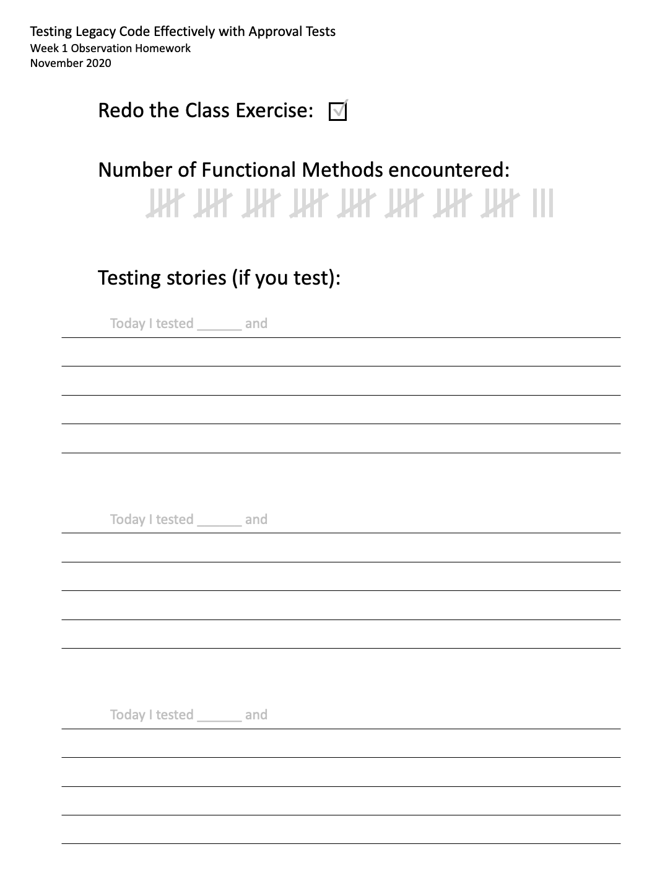
Homework
Redo the exercise, solo
Count functional at work
Stories (if you test)
Notes:
Next week we will build on what we did today
Will need today’s steps to bed in
Ideally get to 100% coverage
See our notes on front page of this repo
If you have any problems at all, please do get in touch – we will can help
Print out this page and keep it at your desk
Any time you see a functional method, just make a mark here
for awareness
If you decide to test it, give a sentence or two about what happened
Optional
Photo and send it to us before the next course

